Slide 1
Traditional Offer and Acceptance
Richard Warner
​

Slide 2
Offer and Acceptance
An offer is
  (1) manifestation by the offeror of a willingness to enter a bargain
  (2) so made as to justify the offeree in thinking his or her assent will conclude the bargain.
An acceptance is
  a manifestation of a willingness to enter the bargain proposed by the offer (in a way invited or required by the offer).

Slide 3
The Note on the Door
There is a note on the lower right hand side of the entrance. It reads:
By entering this room, I agree to pay Richard Warner $100 on demand in exchange for a lecture on contract law.
Is the note an offer?
(a) Yes
(b) No

Slide 4
What Does an Offer Do?
It presents the terms of a proposed bargain.
  This will include a promise.
    Relevant doctrines: interpretation and consideration.
It creates the opportunity to accept or reject them.
It does so by transferring to the offeree the power to conclude the bargain.

Slide 5
Lefkowitz v. Great Minneapolis Surplus Store
The store advertises clothes for sale.
Lefkowitz a buyer shows up and says "I accept".
Is there a contract?
Yes, if the advertisements are an offer.

Slide 6
The advertisements
"Saturday 9 a.m. sharp
3 Brand New Fur Coats
Worth to $ 100.00
First Come, First Served
$ 1 Each"
"Saturday 9 a.m.
2 Brand New Pastel Mink 3-Skin Scarfs
Selling for $ 89.50
Out they go Saturday.
Each . . . . $ 1.00
1 Black Lapin Stole
Beautiful, worth $ 139.50 . . . $ 1.00
First Come, First Served“
Lefkowitz showed up each morning at 9 am and accepted the offers. That is he tried to buy everything. Lefkowtiz owned the store down the street.

Slide 7
A Manifestation of a Willingness to Enter a Bargin?
What is a person who reads the ads suppose to think?
Putting the ad in a newspaper in a manifestation of a willingness to enter a bargain because
  The terms are presented to the newspaper’s readers
  The presentation says, “We want to sell the clothes in the ad on these terms.”

Slide 8
The Manifestation Requirement
The store defended by claiming that the offer was for women only.
The problem was that no “women only” term was in the offer. It was not presented, not manifested.
The court rejects the defense by saying that you can't have "secret conditions" in an offer.

Slide 9
So made . . .
as to justify the offeree in thinking his or her assent will conclude the bargain?
Ask, what are you suppose to think when you read the ad?
You are suppose to think, “If I go to the store and say ‘I will buy this advertised item,’ I can get it.”
That is, you are justified in thinking your assent will conclude the bargain.
Think of the offer as a transfer of deal-making power.

Slide 10
“I have the power”

Slide 11
What Counts As A Manifestation Of A Willingness To Enter A Bargain?
Two possibilities:
  Any indication that one is willing to make a deal.
  An indication that one is willing to make a deal where one specifies the deal in a “definite and complete” way.
    Definite and complete = enough information about what is promised that the court knows what the offeree loses if the promise is breached.
We will understand things in the second way.

Slide 12
Ads From Individual Sellers
I run an ad in the newspaper. It says: "One used Toshiba notebook computer for sale, Model T1200. Price: $500."
Is this an offer?
To answer, we need to discuss the mailbox rule.
Suppose Bob mails an acceptance on June 1. Under US law, that acceptance is effective on June 1. The contract is formed.

Slide 13
The Mailbox Rule
The "mailbox rule”: In asynchronous communication, acceptance takes effect when it is dispatched. So:
  I run an ad in the newspaper on June 1. It says: "One used Toshiba notebook computer for sale, Model T1200. Price: $500.“
  Assume the ad is an offer, and suppose Bob mails an acceptance on June 1.
  Under the mailbox rule, Bob and I have a contract on June 1.

Slide 14
The Problem
On June 2—when I have not yet received Bob’s letter--Alice meets me face to face and says, “I accept.”
Now I have two contracts and only one computer. I have to breach one contract.
No reasonable offeror would put themselves that position.
So: no offeree could be justified in thinking his or her assent would conclude the bargain.
The ad is not an offer.

Slide 15
So What About Lefkowitz?
So why is the ad an offer in Lefkowitz?
Because you are supposed to think, “If I get there in time, and accept the offer, we have a contract.”
And because of “first come, first served.”

Slide 16
The Uniform Deceptive Trade Practices Act
Ads are dealt with by regulatory agencies and statutes-- the FTC and the Uniform Deceptive Trade Practices ACt.
Ads are not treated as unqualified offers. The advertiser is not bound to sell anyone who shows up, but only required to have enough stuff to meet "reasonably anticipated demand".
Think of this as a conditional offer. It splits the risk: the advertiser takes most of the risk.
  The advertiser has to reasonably anticipate demand, and is bound to sell to those who show up until the demand becomes more than reasonably anticipated.
  The customer takes some risk-- he or she might show up after demand has become more than was reasonably anticipated.

Slide 17
Steve Sowle owns and operates “Sowlefully Yours,” an online dating service. Wright owns and operates “Wright Wine,” a wine retailer. Sowle and Wright have been discussing the possibility of holding an online wine tasting on Sowefully Yours. Wright mails the following note to Sowle on December 10:
    Dear Steve, Here’s the deal. We have a bunch of details to work out about the online wine tasting, but can we agree that we will either hold it three months from now or not do it all at? I need to know now that we will do it then if we do it. So, give me your “yes” or “no” to this schedule. If “yes,” I will make sure I can be ready in three months both to serve as an online host and to deliver the wine. Let’s make it March 10. We will have a “date”! Tastefully Yours, Richard
Steve responds by mail with this note on December 11:
Dear Richard, March 10 is a go! Get ready. It will be great. Sowlefully yours, Steve
(a) Wright made an offer and Sowle accepted
(b) Sowle made an offer and Wright accepted
(c) Wright did not make an offer
(d) Wright made an offer but Sowle did not accept

Slide 18
Harris v. Time Warner, 191 Cal.App.3d 449 (1987): “The front of the envelope contained two see-through windows partially revealing the envelope's contents. One window showed Joshua's name and address. The other revealed the following statement: “JOSHUA A. GNAIZDA, I'LL GIVE YOU THIS VERSATILE NEW CALCULATOR WATCH FREE Just for, Opening this Envelope Before Feb. 15, 1985.” Beneath the offer was a picture of the calculator watch itself. Joshua's mother opened the envelope and apparently realized she had been deceived by a ploy to get her to open a piece of junk mail. The see-through window had not revealed the full text of Time's offer. Printed below the picture of the calculator watch, and not viewable through the see-through window, were the following additional words: “AND MAILING THIS CERTIFICATE TODAY!” The certificate itself clearly required that Joshua purchase a subscription to Fortune magazine in order to receive the free calculator watch. Although most of us, while murmuring an appropriate expletive, would have simply thrown away the mailer, and some might have stood on principle and filed an action in small claims court to obtain the calculator watch, Joshua's father did something a little different: he launched a $15 million lawsuit in San Francisco Superior Court.” The court notes that “The text of Time's unopened mailer was, technically, an offer to enter into a . . . contract: the promisor made a promise to do something (give the recipient a calculator watch) in exchange for the performance of an act by the promise (opening the envelope).” Is the court correct?
(a) Yes
(b) No

Slide 19
Klar v. H. & M. Parcel Room (1946)
Klar checked a package containing fur skins with the railroad parcel room.
The charge was 10 cents ($1.50 in 2022).
He received a “parcel check . . . of cardboard three inches in length and two and one-half inches in width. It had [1] conspicuously printed on its face at the bottom the identifying number in red type one-half inch high. [2] Upon the upper portion of the receipt . . . there appeared in red letters one-quarter inch high the word ‘Contract’ and [3] directly underneath in finer type (legible on close inspection), crowded in a space less than an inch in width and running across the face of the stub, the following language: . . Loss or damage—no claim shall be made in excess of $25.00 for loss or damage to any piece.”

Slide 20
A Limitation On Damages?
The parcel room mistakenly—and negligently—gave the package to another person.
Klar claimed the fur skins were worth $1000.
Does “no claim shall be made in excess of $25.00 for loss or damage to any piece” limit the damage to $25.00?
It can—if the presentation of the parcel check was an offer Klar accepted.
The question is whether Klar accepted and offer made by the parcel room..

Slide 21
Presentation Of The Agreement
The majority: “there were no conspicuous signs or large placards . . . . calling attention to the limitation of liability, nor is there evidence that plaintiffs had any other form of notice which embraced the terms of a special contract . . . In the absence of any of these items of proof, it cannot be said that a mere acceptance of the parcel check by the bailor with the printed matter thereon, as a matter of law, sufficiently brought to plaintiffs' attention the limitation of liability.”
The dissent: “The parcel check that Ellis received had conspicuously printed the word ‘Contract’ on the face thereof near the top in bold face type, clearly legible in red ink. The word ‘Contract’ in black ink was repeated twice in the express limitation of liability to $25 printed immediately below on the face of the card.”

Slide 22
Did the parcel room make an offer?
(a) Yes
(b) No

Slide 23
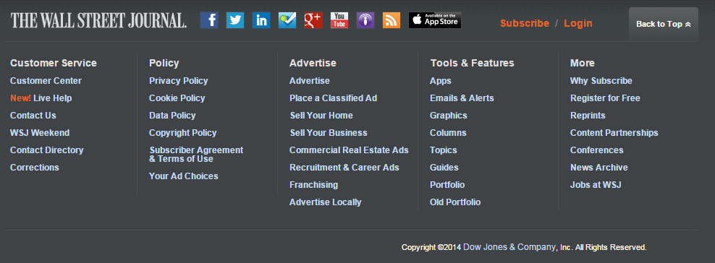
Is This An Offer?
(a) Yes
(b) No

Slide 24
The Rule
Online agreements constitute an offer as long as a reasonable website visitor would be on constructive notice (= should be aware) that he or she is being invited to enter a contractual relationship under the terms accessible via a hyperlink.

